Slide 1
ServiceNow
IT Service Management Blueprint
Project 3
Notes:
Over the course of our training, we have been learning and working within the ServiceNow Platform…

Slide 2
ServiceNow
Project Overview/Team Breakdown
Incident Management
Problem Management
Change Management
ServiceNow Demonstration
Q&A
Notes:
For today’s presentation, we will discuss each group’s work within ServiceNow, followed by a demonstration of each form. But first, I’ll talk about what ServiceNow is…

Slide 3

What is ServiceNow
ServiceNow is an IT Service Management platform, allowing for automated, standardized, and custom IT functionality
Notes:
“Servicenow is an IT Service Management Program, used to fulfill any IT needs a business may require. It provides tools to automate processes, standardize information, and create custom functionality to achieve any business goal.

Slide 4
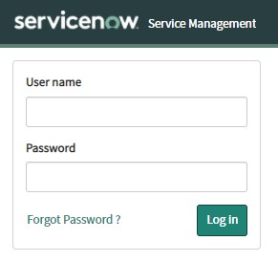
ServiceNow Cont.
Instance URL: https://dev105680.service-now.com/
Notes:
ServiceNow Development Environments are called Instances, each containing applications and modules to manage and perform business needs…

Slide 5
Project Goal
Create and update ServiceNow Applications for Incident, Problem, and Change records
Provide custom functionality through various development tools
Notes:
Mention that all teams worked within the same instance….

Slide 6
Functional Requirement Specification
The FRS Document is used to outline the technical tools, methods, and eventual outcome of an IT Service Management Project
These requirements will discuss how the project requirements will be met from the technical side

Slide 7
Team Breakdown
Instructor: Prakash Agrawal, ServiceNow
Co-Instructor: Jasdhir Singh, JavaScript/Angular/HTML
Incident Group | Problem Group | Change Group
Sean Musgrave (Lead) | Austin Magno (Lead) | Sam Hagadorn (Lead)
Chris Rodrigues | James Hardy | Bernice Templeman
Joseph Ledesma | Malykai Mejia | Freddy Perez
Kpumbu Jaidzeka | Jimmy Merrick | Jaquina Porterfield
Phillip Caruthers | Zach Funderburk (Project Manager) | Michael Myers
Notes:
For this project, our batch of 15 split into smaller groups of 5, one group working on each Application. Each team had a Team lead, and I served as the Project Manager. While each team worked on the individual applications, the team leads and I worked to ensure a smooth connection between the applications, and to help keep everything being uniform across our work. We will now hear from each team as they discuss the work they did for their application.

Slide 8
Incident Management

Slide 9
What is Incident Management and Why should we update the Incident Application?
The Incident Application is a useful tool for logging and tracking Incidents. Incidents can be submitted by end users with no ServiceNow roles, or team members with limited roles, ITIL users or ServiceNow administrators. However, out of the box, the Incident Application is missing some important features.
Our team has been tasked with modifying the layout and behavior of the Incident Application to better suit the needs of potential customers.
Notes:
Sean: Incident is a built in application in servicenow to log and tack all created Incidents. So the question is why do we need to make changes when the incident application if it is already available out of the box? All the base tools are already built on the platform yes, but there is very limited added verification and validation. For example an end user can submit a ticket and change the states progressing the incident themself. Our main goal was to add these validations so only the correct people are able to perform actions on the incident records at any given time. We also added additional features not found out of the box including some additional applications/modules, scripts, buttons, links and notifications that we will discuss in the rest of this presentation. I will now pass it off to Joseph to explain this further.

Slide 10
How does it work?
The Incident Application is designed to handle any and all disruptions to a service, when a user enters the pertinent details of an Incident and submits the ticket, the correct team will handle the disruption.
Once a ticket has been submitted, the state will automatically change from “New” to “In Progress” this means the team responsible for the ticket now has been notified.
From this point, the user who has submitted the ticket will no longer be allowed to edit the ticket, unless we require more information to fix the issue.
After the issue has been Resolved, the user will confirm or deny whether the fix we implemented works correctly.
Notes:
Joseph: Thank you Sean, Incident Management is handled in the Incident Application, which is designed around handling disruptions in service or answering questions and inquiries by users. In our instance, a user will enter the pertinent details of the incident in question and submit a ticket.
A submitted ticket will automatically fill in relevant details and through Assignment Rules will assign a group to handle the incident, arriving to the ticket handler as “In Progress”, having been notified of the new ticket.
From there, anyone not handling the ticket cannot edit the ticket. Once the issue is resolved, the end user will confirm or deny whether the fix implemented works as intended.
Next up handling form transitions is Phillip ->

Slide 11
Form Transitions
The state of the Incident impacts the layout of the form, as well the as the role of a user which will be covered later.
Examples of state field are “New”, or “On Hold”, these affect the form because these states require certain information to be displayed or withheld.
Notes:
Phillip
Thank you Joseph
Form transitions impact the layout of the form through the state field or the role of a particular user which we will cover later. Some example of states are New or On Hold, which affect the form because these states require certain info to be displayed or withheld. In the next slide we will cover state transitions.

Slide 12
State Matrix
State | To New | To In Progress | To On Hold | To Resolved | To Closed | To Canceled
From New |  | ✔
From In Progress |  |  | ✔ | ✔ |  | ✔
From On Hold |  | ✔ |  | ✔
From Resolved |  | ✔ |  |  | ✔
From Closed
From Canceled
Checkmark indicates whether the user can go to these states
Notes:
Phillip
The state matrix seen here demonstrates how states can be moved. As you can see, “New” can only be moved to “In Progress”. “In Progress” likewise can only be moved to on hold, resolved, or canceled. The bottom two rows, the Closed and Canceled states aren’t editable because they are considered finished, which means the Incident fix has either been implemented or a team member has determined the Incident needs to be canceled.
Pass to Chris for validation and flow

Slide 13
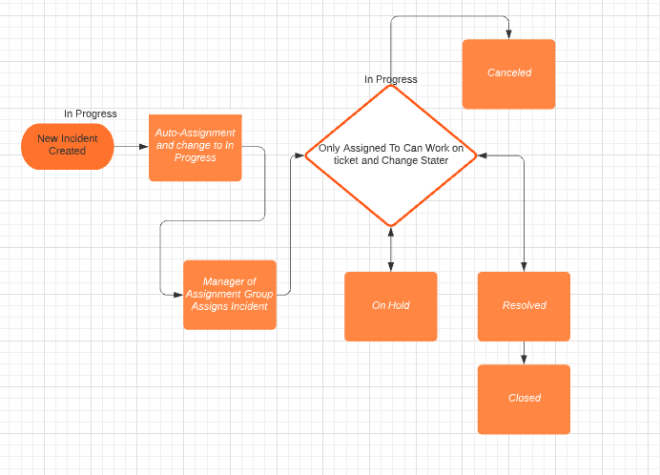
Validation and Flow
Notes:
Chris- I’m going to go through the life cycle of any incident that goes through the incident process. New incidents can be created by any end users. When the incident has been submitted it auto-assigns the incident to a manager and changes the state to in progress. Once it has been assigned, only the person who has been assigned the incident can make changes to the ticket such as change the state or worknotes. From the in progress state an incident can move to on hold if more info is needed from the end user it will move to the on hold state. The ticket will move back to in progress once the user provides the necessary information. However if the issue does not persist or for any reason is not valid te incident can be cancelled. if the assignee finds a solution to the issue it will move to the resolved state. If for any reason the end user is not satisfied with the solution provided they can move it back to in progress. Should the user accept the solution they can close the ticket or will auto close in 7 days. I’ll now pass it to kpumbu to talk about the application and modules.

Slide 14
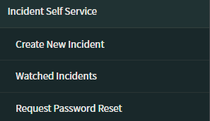
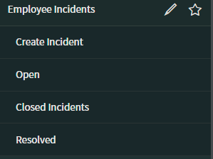
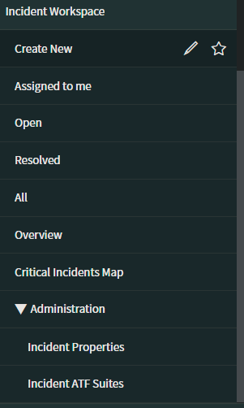
Applications and Modules
Three Separate Applications with Different Modules
Access Determined By Role
Roles also Determine Views within Applications
Notes:
Kpumbu: Application menus and modules are the building blocks of the ServiceNow application navigator which is located on the sidebar of an instance. Here applications are designed around how we visioned the instance to be used. Three applications were created in this project as follows: a self service application for end users with no roles and has 3 modules, an employee incidents application for inhouse employees to submit tickets that has 4 modules, and a final Workspace application for users who will be working on resolving the incidents which has 8 modules & 2 sub-modules. Each application has different options available which are relevant to the person who will use them. Each application is also linked to a separate View. These views determine the form layout whereby only the relevant fields are available to be viewed and changed based on the users role.
Now I’ll pass it to Joseph to discuss some of the fields that were relabeled on the form.

Slide 15
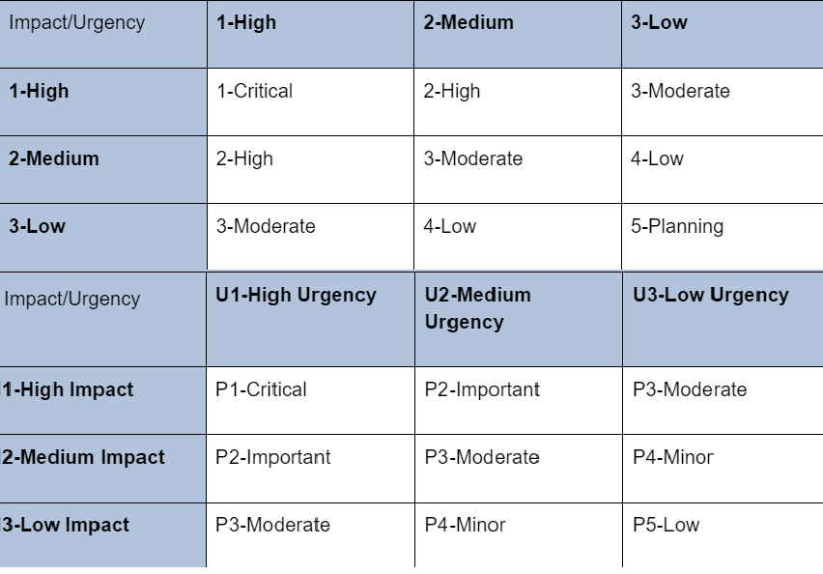
Priority/Impact/Urgency Labels
Notes:
Joseph: Thank you Kpumbu, most of the changes we made were in the sys_choice table for the Priority, Impact, and Urgency labels. The reason for this was to increase the clarity of their order with one being the highest and 3 being the lowest. These changes only reflect in the Incident table as a dictionary override to avoid overlap with other applications.
With Incident Task and Problem generation we have Phillip once again ->

Slide 16
Incident Task and Problem Generation
Flow Designer is used to automatically create Incident Tasks and Problems
Incident Task generation
Problem generation
Mandatory Problem Record fields are copied from Incident
Notes:
Phillip
Thanks again Joseph
The Flow Designer is an application that we’ve utilized to automatically create Incident Tasks and Problems under certain conditions. An incident task is generated for High Priority or P1 incidents, a problem is generated when incident is put in the On Hold state with On Hold Reason field selected as “Awaiting Problem”, and in that problem the mandatory problem fields are copied from incident.
Pass to Sean for assignment rules

Slide 17
Assignment Rules
New Incident is Created
Assignment Rule’s control which group is assigned the incident
Based on fields input into the form(Priority and Category)
Transition into the In Progress state
Notes:
Sean: When a new incident is created, assignment group on all forms is a read only fields and can not be selected. Based on the category of the incident selected during creation and assignment group is automatically chosen and populated. If the incident is P1 which is a high priority incident, it is assigned to a special P1 incident group automatically. A script transitions the ticket from the New to In Progress state when this assignment group is filled, so tickets submitted automatically progress to the In Progress State. I will now pass it off to Kpumbu to discuss the related searches field.

Slide 18
Contextual Search
There is a search feature available to utilize, and this is designed to reduce the number of tickets that we have to fix by reducing duplicates.
This feature is based on the short description field and identifies articles that have been included in the Knowledge Base.
Included on all new incidents in the Default and Self Service views.
Ideally an end user may find an answer to their issue before submitting the incident, reducing the number of tickets.
Notes:
Kpumbu: Contextual search is a search technology that focuses on the context of the query as well as the intent of the user in order to fetch the most relevant set of results. This feature is linked to the short description field and identifies articles that have been included in the Knowledge Base repository. It is possible to define other fields and link them to the contextual search feature. Here we need to type is summary of the problem and the context field will display proposals related to the summary. For the purpose of this project, It is set up only in the Default and Self service views and is expected to help end users find answers to their issues even before submitting the incident. I will pass it over to Chris to talk about Incident Form Views.

Slide 19
Incident Form Views
We have created three different views of the incident form based on the roles of users as well as for users without roles. A view defines the elements that appear when a user opens a form or a list. They are as follow:
Default view: This view is displayed for all employees of the company who are not part of the ServiceNow Technical Team.
Self Service view: This View is displayed for all other users outside of the company who wish to create an incident. This view is the most limited with few fields
Workspace view : This view is available only to the ServiceNOW Technical Team (Administrators and users with special roles that have permission to do certain tasks). This view has the broadest scope. Admins have access to all fields available on the platform.
Notes:
Chris- The incident Form has 3 views to restrict access to fields based on the roles associated with that view. This means each views is designed to be accessible to different target groups. The self service view is accessible by all end users employees or otherwise. The default view is accessible to all employees within the company, thus they can interact with fields that people outside the company cannot . The workspace view is only available to a select group of employees who are given access to this view. This View has the broadest scope and can see all available fields. With higher access comes higher responsibilities or in this case form fields. Now I’ll pass it onto Philip to talk about the different form fields and about UI policies.

Slide 20
Form Fields and UI Policies
UI Policies are a type of scripting that we’ve incorporated to make the forms look a certain way
Fields are set to not visible until they are relevant
A field that is mandatory during one stage will be read-only for the remainder of the incident process
The use of read-only fields at any level is for users to view the field information without the ability to manipulate the information
Notes:
Phillip
Thank you Chris
We’ve utilized scripting to make the Incident form look and behave certain ways. Scripting in ServiceNow is done using JavaScript mostly, and this applies to both server side and client side. For Incident Management, we’ve crafted quite a few UI Policies to shape the form views described by Chris. UI Policies are JavaScript based and can alter 3 areas: the visibility of a field, making a field mandatory, and marking a field read only.
Pass to Joseph for UI actions

Slide 21
UI Actions
UI Actions are buttons, links, and context menu items on forms and lists. They are used to make the User Interface more interactive, customized and specific to user activities.
When the button, link or context Item menu is clicked, it performs a particular action based on the specific configuration. For example a save button, Link to other functionalities.
Notes:
Joseph: Thanks again, Phillip. UI Actions are your buttons, links, and the context menu items on forms and lists. Their use is convenience and interactivity, highly customizable and specific to an activity. Our use of UI Actions was to conveniently allow Incident Management staff to troubleshoot or view the relevant Service Level Agreement and tasks, or to create a problem from the viewed incident. We aimed to simplify the view and to not clutter it with too many options.
Chris is up next with notifications ->

Slide 22
Notifications
New Incident
On Hold
Resolved
Closed
Priority 1
SLA Breach
Notes:
Chris- Notifications are the primary form of communication between system administrators, internal employees & end users. We can use & customize email notifications to keep users informed of events that concern them. There are 271 various OOTB Notifications that deal with a range of aspects from monitoring Servers or for CI Management but in incident management we focus on 6 essential notifications that we have customized to aid in the flow of incident management. The first 4 directy deal with incident management. The New incident is an email notification used as a confirmation to the end that his incident has been recorded in the system. As the name suggests the on hold email notification lets the user know that work on this incident has been paused. This notification will also let him know why and whether he has any role to play to continue. The priority 1 notification is a notification to the response team to let them know there is a new priority 1. The SLA breach notification lets the manager know that the time assigned to resolve an incident has been passed and needs to be addressed.

Slide 23
Problem Management

Slide 24
Problem Management Agenda
Overview
Data Security
Form Interface
Form Layout
Notifications
Notes:
Austin:
Thank you Zach. My name is Austin and I am the team lead for problem management. Our team’s responsibility is to customize the problem application to make it suitable for end users. The five topics that you see here will cover some of the changes we made to the application. Before going through the details, I believe it is important to define the purpose of problem management.
(Next Slide)

Slide 25
Problem Management Overview
Diagnose cause of recurring incidents
Keep a record previous problems
Problem Lifecycle
Notes:
Austin:
The purpose of problem management is to diagnose and resolve the cause of recurring incidents. Problem management also keeps a record of previous problems so if a similar problem comes up in the future, resolution can be faster. Problem resolution is done by going through different stages of the problem lifecycle. Each stage has a corresponding requirement that has to be completed in order to move to the next stage. We will see them in action during the demonstration.
Next up is Jimmy to discuss our application and modules…
(Next Slide)

Slide 26
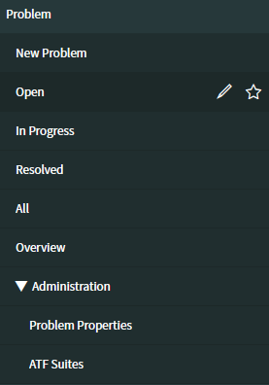
Applications and Modules
Notes:
Jimmy
Thank you Austin! The modules we decided to go with are New Problem, Open, In Progress, Resolved, All, Overview, and Administration. The OOB modules we kept are the New problem, Open, All, and Overview. We decided to make additional modules for the In Progress and Resolved, since those are custom states we added to our problem application. As you will see in the demonstration the new problem will render the new problem form. While, Open, In Progress, Resolved, and All will show the list view of their respective states.
I will now pass it to James for Data Security.

Slide 27
Data Security
Security / Data Management Tools Used:
Data Policies: server-side ~ (mandatory / read only / visible)
UI Policies: client-side ~ (mandatory / read only / visible)
UI Actions + Script Includes ~ (performance and validation)
Business Rules: server-side ~ (database triggers for automation)
Notes:
These tools all contribute towards the end goal of data security / integrity; while creating and maintaining a secure environment for data entry, modification, upload, and storage.
Now over to Zach
(Next Slide)

Slide 28
Form Interface
Problem Form buttons were created to move the problem along its lifecycle, as well as save any updates or cancel the problem if needed
The UI Buttons will move the problem from stage to stage
These buttons will only be available for the Assigned User or the system administrator
Notes:
Zach:
When using the Problem form, a number of available actions will be set for the user as buttons, located in the upper right corner of the form page. These tools will allow the user to move the problem along in its lifecycle stages, as well as update the problem’s data or cancel the problem. Here we can see an example group of the action buttons available, which will vary depending on the stage the problem is in. Next we will look over the Problem Form Layout…
(Next Slide)

Slide 29
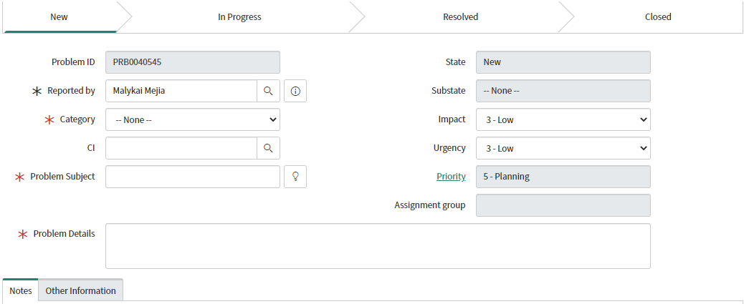
Form Layout
The Problem form will show all necessary fields a user will need to report a new problem.
Some fields will automatically fill in with data (ID, Name)
Some fields are set to be uneditable
Some fields can be optional.
Notes:
Presenter
Transcript
The problem form is where all the general information for the problem is placed for submission and review. details like who reported the problem, what the problem is and who is responsible for finding a solution would be found here. To ensure that the necessary information to resolve a problem has been supplied, some areas of the form have been labelled as "required". Meaning, the form cannot be submitted without them. These areas are marked by the red asterisk. Some of these fields have even been marked uneditable. These areas of the form, along with a few others, will auto generate information based on the conditions of the form and it’s required fields. Near the bottom of the form, sectional tabs will be in view. These areas allow additional information to be both viewed and inserted into the new record.
Once filled and submitted,The Process flow seen at the top of the form will fully initiate and the problem solving process will begin. I will now turn it back over to Jimmy for Notification information.
(Next Slide)

Slide 30
Notifications
Email notifications
Triggered by server-side process
Sent out upon:
Creating new Problem
Problem condition changes
Generation of problem tasks
Closing out Problem
Sent to assigned to field and assignment group field
Notes:
Jimmy
The notifications we utilized were emails. The emails will be triggered via a server-side process known as a workflow. The workflow checks the fields: state and substate on the problem. Depending on the state or substate, a corresponding email will be sent out to the appropriate person. After the notification there is a pause in the workflow that checks when the state or substate is changed, and it proceeds to check if the problem is in the next state. The emails will be sent when creating a problem, when the problem condition changes, when the problem generates problem tasks, and finally when closing out the problem.
I will now hand it back to Zach.
(Next Slide)

Slide 31
Change Management

Slide 32
What is Change Management
A change request is a formal procedure to implement change in a way that ensures successful implementation but provides a backout plan in case changes do not perform as planned.
Notes:
c

Slide 33

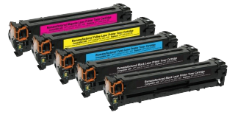
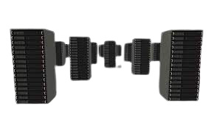
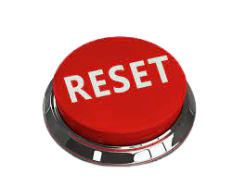
Types of Change
Standard
Normal
Emergency
Major
Notes:
Standard - pre-authorized, low-risk change that follows specified procedure, i.e. replace toner, reboot server
Normal - mid-level request that requires authorizations and Change Advisory Board approval (CAB), i.e upgrade server, operating system update
Emergency - time-sensitive “fix-or-fail” request, does not need authorization but goes straight to CAB approval, i.e. reboot applications server
Major - high-level change with preliminary planning tasks in addition to multiple authorizations and CAB approval, i.e. bringing on new server location
I’ll pass it over to Michael to talk about the change management process

Slide 34
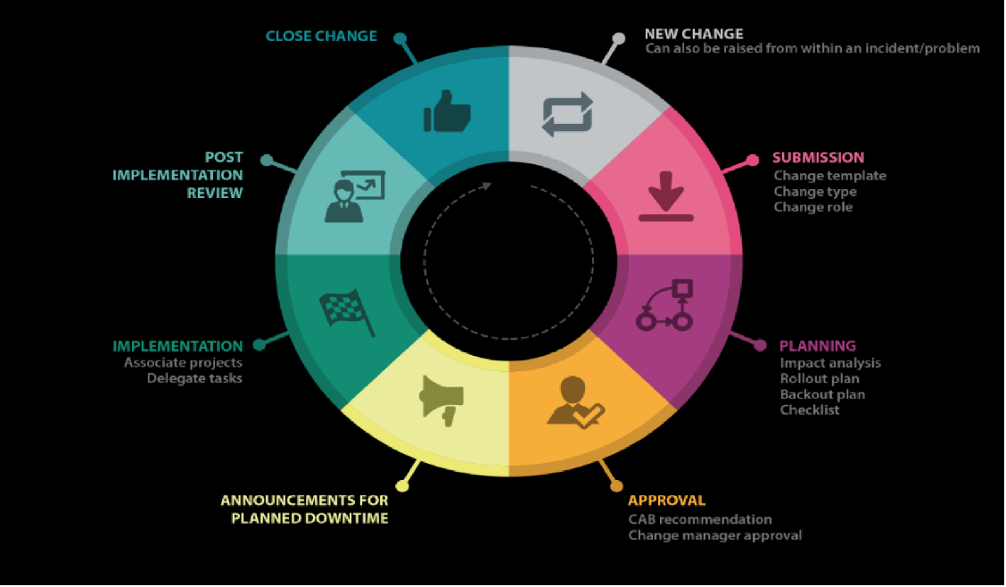
Change Management Process
Notes:
MIchael - New Change through Approval

Slide 35
Change Request Lifecycle
New
Assess
Authorize
Scheduled
Implement
Review
Closed
Canceled
Notes:
Thank you Michael
Good Afternoon I am Freddy Perez
Change Request Lifecycle
8 lifecycle stages
First we start with the New state - The New state lets you start the form and choose the type of change and gather required information
In the Assess state a working group manager is assigned and assesses the request
In Authorize- the change has been approved and must be reviewed by CAB or ECAB(Emergency Change Advisory Board)
Scheduled-once the CAB is approved, work notes has to be added before it is implemented
In Implement- Tasks are created to complete the change
Then we go to Review- where Implementations are reviewed to see if they were successful or unsuccessful
Closed- All tasks and implementations have been completed no more information could be altered in this state
Lastly in Cancelled-A User is able to cancel the change request at any state before Review, this could be achieved through the cancel change button on the form banner
Pass it on to Jaquina for Change Modules

Slide 36
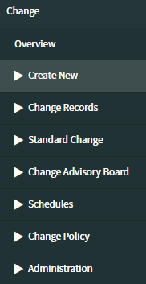
Change Modules
Overview
Create New
Change Records
Standard Change
Change Advisory Board
Change Policy
Administration
Notes:
Jaquina
Overview - Dashboard with counts, graphs and calendar for quick reference
Create New - Create all new change requests, Standard change requests are through included Standard Change Catalog
Change Records - Access already created change request records
Standard Change - Access standard change templates
Change Advisory Board - Access CAB modules, Schedules, Access schedule rules and definitions
Change Policy - Workflows and definitions based on business rules
Administration - Define models, properties and conditions, also access ATF suite

Slide 37
Change Request Considerations
Planning
Schedule
Conflict
Notes:
Bernice
Planning - Justification, Implementation Plan, Risk and Impact Analysis, Backout Plan, Test Plan
Schedule - Planning start/end date, CAB meetings
Conflict- Conflicts Detected

Slide 38
How to Create a Change Request
From an Incident
From a Problem
From a Configuration Item
Manually through Change Module
Copy active or canceled change request
Notes:
Bernice
Change requests can be created several different ways.
From an Incident
From a Problem
From a Configuration Item
Manually through Change Module
Copy active or cancelled change request

Slide 39
ServiceNow Demonstrations

Slide 40
Team Shout-out

Slide 41
Questions

Slide 42
Thank you!

